Slide 1
Scientific Machine Learning and Tensorflow tutorial
Introduction and TensorFlow basics
Ravi G Patel
Scientific Machine Learning Department
February 1 – 2, 2024
Numerical PDEs: Analysis, Algorithms, and Data Challenges
ICERM
Brown University
SAND2024-00806O

Slide 2
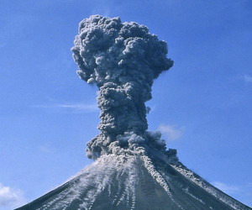
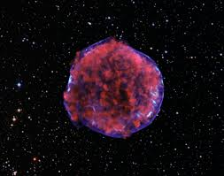
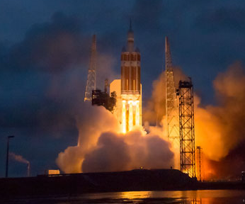
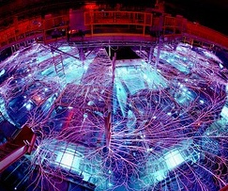
The goal of scientific machine learning
Given experimental/high fidelity simulation data from a system,
Find a mathematical model that describes the system
Experiments/simulations generate noisy, biased, sparse data

Slide 3
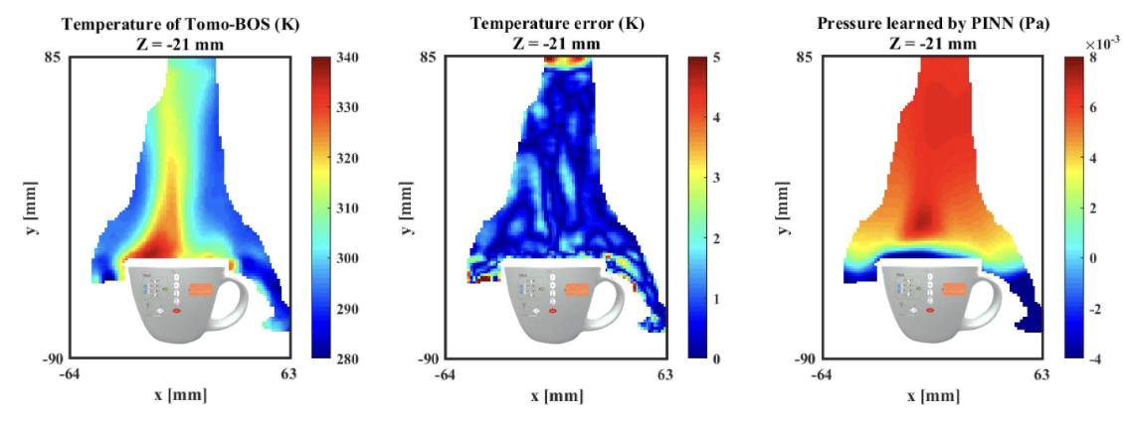
Where is Scientific machine learning used?
PDE Inverse problems
PINNs infers the Pressure of the flow over a coffee mug from Tomographic background oriented schlieren images S. Cai et al., JFM (2021)

Slide 4
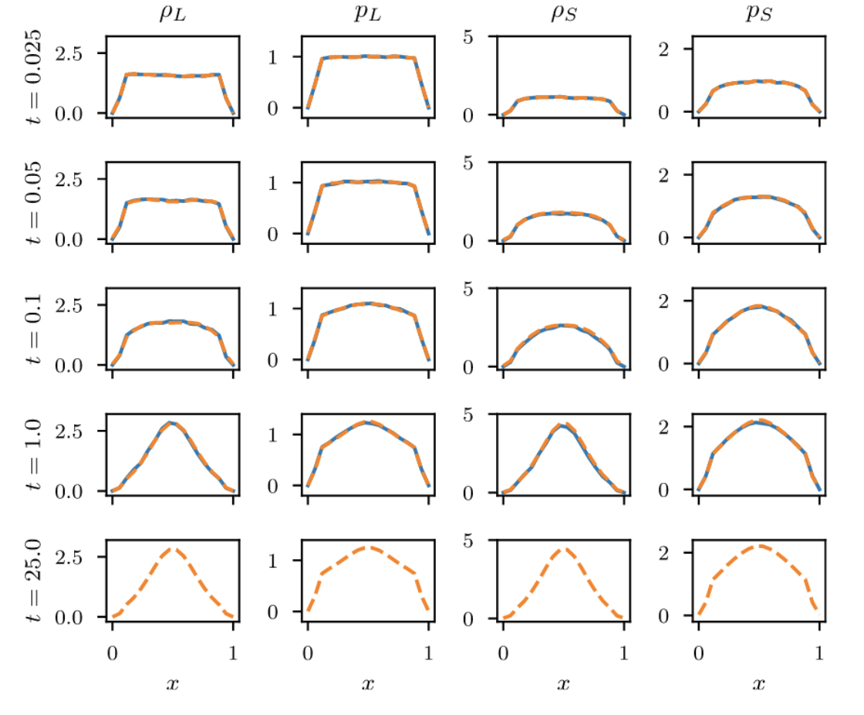
Where is Scientific machine learning used?
Surrogate modeling
ΔP
W
MOR-physics learns dynamics of colloidal system from molecular dynamics simulations R. Patel et al., CMAME (2021)

Slide 5
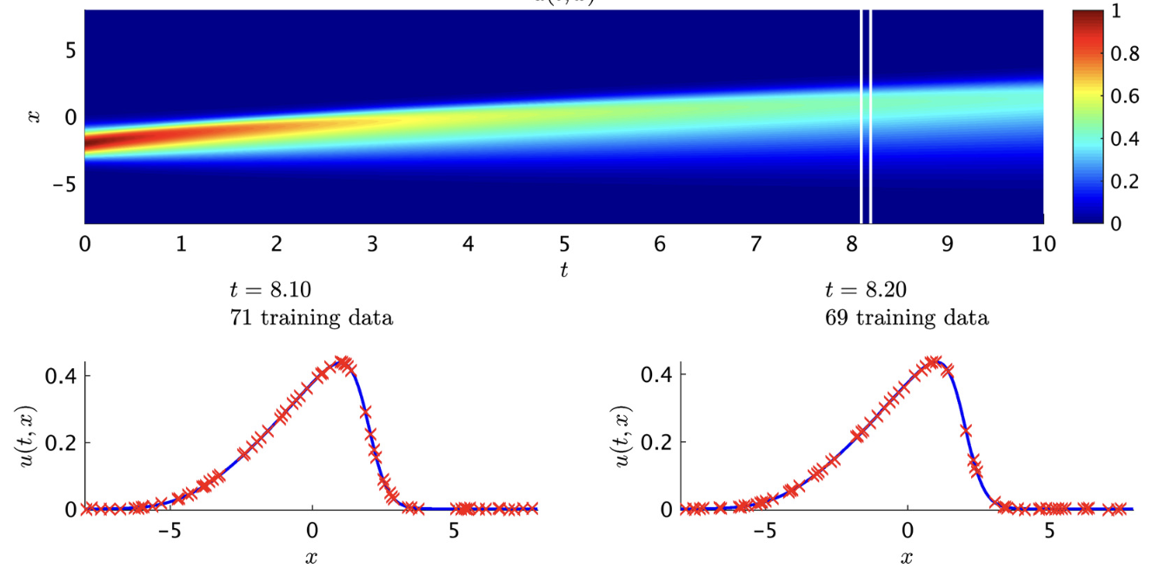
Where is Scientific machine learning used?
System Identification
A Gaussian process is used to recover a PDE from data M. Raissi and G. Karniadakis, JCP (2018)

Slide 6
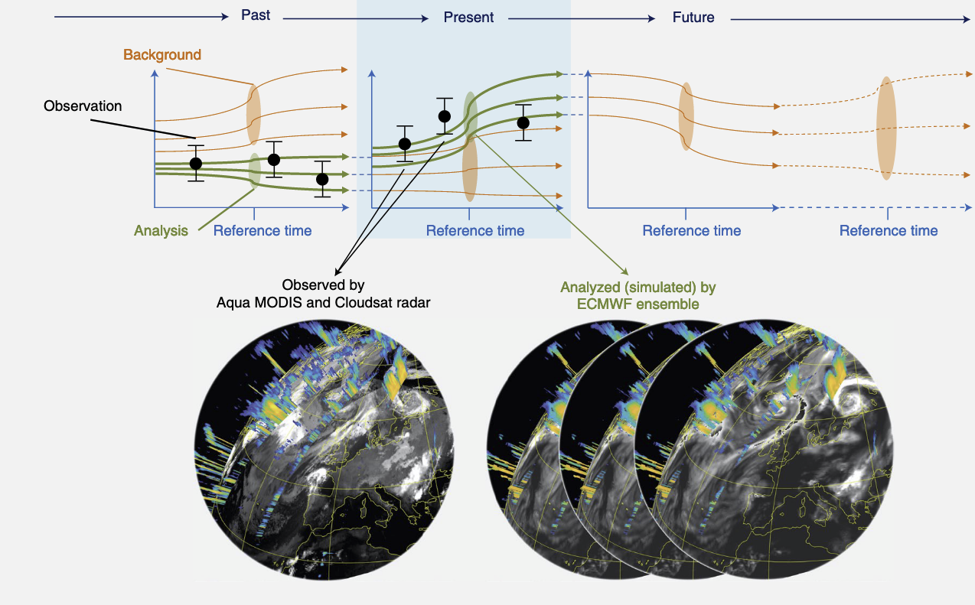
Where is Scientific machine learning used?
Digital Twins
An Earth digital twin - combining MODIS and Cloudsat observations with ECMWF simulations Bauer et al., Nature Computational Science, 2021

Slide 7
Components of scientific machine learning
Physics
Computer Science
SciML
Statistics
Engineering

Slide 8
Tutorial Topics
TensorFlow Basics
Neural Networks
Bayesian inference
Physics Informed Neural Networks
Operator Learning
Gaussian Processes

Slide 9
schedule
Day 1
Time | Topic
9:00am – 9:45am | Introduction and TensorFlow basics
9:45am – 10:15am | Neural networks I
10:15am – 10:30am | Coffee Break
10:30am – 11:30am | Neural networks II
11:30am – 1:30pm | Lunch/Free Time
1:30pm – 4:00pm | Physics informed neural networks and inverse problems
4:00pm – 4:30pm | Coffee Break
4:30pm – 5:00pm | Bayesian inference and Gaussian Processes I

Slide 10
schedule
Day 2
Time | Topic
9:00am – 10:15am | Bayesian Inference and Gaussian Processes II
10:15am – 10:30am | Coffee Break
10:30am – 11:30am | Operator Learning I
11:30am – 1:30pm | Lunch/Free Time
1:30pm – 3:30pm | Operator Learning II
3:30pm – 4:00pm | Coffee Break
4:00pm – 4:30pm | Advanced topics. Future directions. Reproducibility.
4:30pm – 5:00pm | Open Discussion

Slide 11
Tensorflow Overview
Tensorflow – linear algebra with automatic differentiation and accelerator support
Concepts
Tensor data type
Accelerators
GradientTape
Addons
Keras
Optimizers
Tensorflow probability

Slide 12
Tensorflow vs. numpy
Numpy
Tensorflow
import numpy as np
Operates on np.array type
np.zeros, np.einsum, np.arange, np.shape
np.concat, np.sum, A.T
import tensorflow as tf
Operates on the tf.tensor type
tf.zeros, np.einsum, tf.arange, tf.shape
tf.concatenate, tf.reduce_sum, tf.transpose(A)
Accelerator support
Automatic differentiation

Slide 13
Tensorflow example code
TensorType
Similar to numpy arrays, but with accelerator support and automatic differentiation
Constants once instantiated cannot be modified
In [1]: tf.constant(4.) Out[1]: <tf.Tensor: shape=(), dtype=float32, numpy=4.0>
Variables (i.e. parameters) can be reassigned values
In [2]: a = tf.Variable(4.) In [3]: a.assign(3.) Out[3]: <tf.Variable 'UnreadVariable' shape=() dtype=float32, numpy=3.0>
The standard `=` operator will create a new tensor
Accumulation operators like `+=` will give an error
For optimization, we typically will use `assign` to update Variables (i.e. parameters)

Slide 14
Tensorflow example code
GradientTape
Compute gradients using the following syntax,
GradientTape tracks operations and adjoints for backprop
More details in next topic
Can only compute the gradient of a scalar
Will sum over first argument if it’s not a scalar
GradientTape can also be used to compute Hessians and Jacobians
https://www.tensorflow.org/guide/advanced_autodiff
x = tf.constant(2.) with tf.GradientTape() as tape: tape.watch(x) y = x**2 tape.gradients(y,x)

Slide 15
Tensorflow example code
Eager mode
TensorFlow offers two computational modes
Eager mode is the default mode
Behaves much like standard Python but is much slower
Easier to debug
Code so far has all been in eager mode
A = tf.random.normal((25,250,2500)) B = tf.random.normal((2500,250,25)) def DoubleDot(A,B): return tf.einsum('ijk,kjl',A,B)
In [1]: %%timeit ...: DoubleDot(A,B) 8.54 ms ± 192 µs per loop (mean ± std. dev. of 7 runs, 100 loops each)

Slide 16
Tensorflow example code
Graph mode
Graph mode is much faster but more restrictive. To invoke Graph mode
Write a Python function with TensorFlow operations
Pass the function through `tf.function` or decorate one with `@tf.function`
First run will be slow
DoubleDot_graph = tf.function(DoubleDot)
@tf.function(jit_compile=True) def DoubleDot_graph2(A,B): return tf.einsum('ijk,kjl',A,B)
In [1]: %%timeit ...: DoubleDot_graph(A,B) 1.11 ms ± 146 ns per loop (mean ± std. dev. of 7 runs, 1,000 loops each)
In [2]: %%timeit ...: DoubleDot_graph2(A,B) 1.11 ms ± 168 ns per loop (mean ± std. dev. of 7 runs, 1,000 loops each)

Slide 17
Tensorflow example code
Just-in-time compilation
We can further speed up TensorFlow code by specifying just-in-time compilation (XLA) in tf.function,
@tf.function(jit_compile=True)
def DoubleDot_jit(A,B):
return tf.einsum('ijk,kjl',A,B)
In [1]: %%timeit
...: DoubleDot_jit(A,B) 260 µs ± 269 ns per loop (mean ± std. dev. of 7 runs, 1,000 loops each)

Slide 18
Tensorflow example code
Executing on accelerators
By default, TensorFlow will try to execute code on the GPU
We can explicitly tell it to execute on a specific device,
In [1]: %%timeit
...: with tf.device('/CPU:0'):
...: DoubleDot_jit(A,B)
8.35 ms ± 80.8 µs per loop (mean ± std. dev. of 7 runs, 100 loops each)
In [2]: %%timeit
...: with tf.device('/GPU:0'):
...: DoubleDot_jit(A,B)
262 µs ± 319 ns per loop (mean ± std. dev. of 7 runs, 1,000 loops each)

Slide 19
Tips and tricks
Eager mode is more robust and provides better error messages than graph mode
Check code in eager before switch to graph mode
Check code in graph mode without JIT before enabling JIT
Avoid using numpy code and operations with side effects inside a tf.function
Use Jupyter’s built-in debugger
Applying operations to the wrong shapes is the most common error
Check the shape of inputs to/outputs of operations
TensorFlow is much less forgiving than numpy with respect to precision
By default float32 vs. numpy’s float64
GradientTape must be used with tf.tensor. np.array’s won’t trace
You’ll likely do some tensor transposing and reshaping,
e.g., to use linear algebra operations,
TensorFlow and numpy are not one-to-one. Check the documentation, https://www.tensorflow.org/api_docs

Slide 20
Hands on exercises
We’ll split up into 10 groups, each with an assigned instance
Amazon EC2 with 4 vCPUs and 1 Nvidia T40 GPU
Only up until tomorrow night – save data offline
We’ll be using the Jupyter lab to do the exercises
Web browser-based development environment
Collaborative – group members will share same Jupyter
The instances have all been started already
Run the following command in your terminal,
I’ll give each group their <ip>
and in your browser, navigate to
http://localhost:8888 (password is icerm2024)
$ ssh -L 8888:localhost:8888 icerm2@<ip>

Slide 21
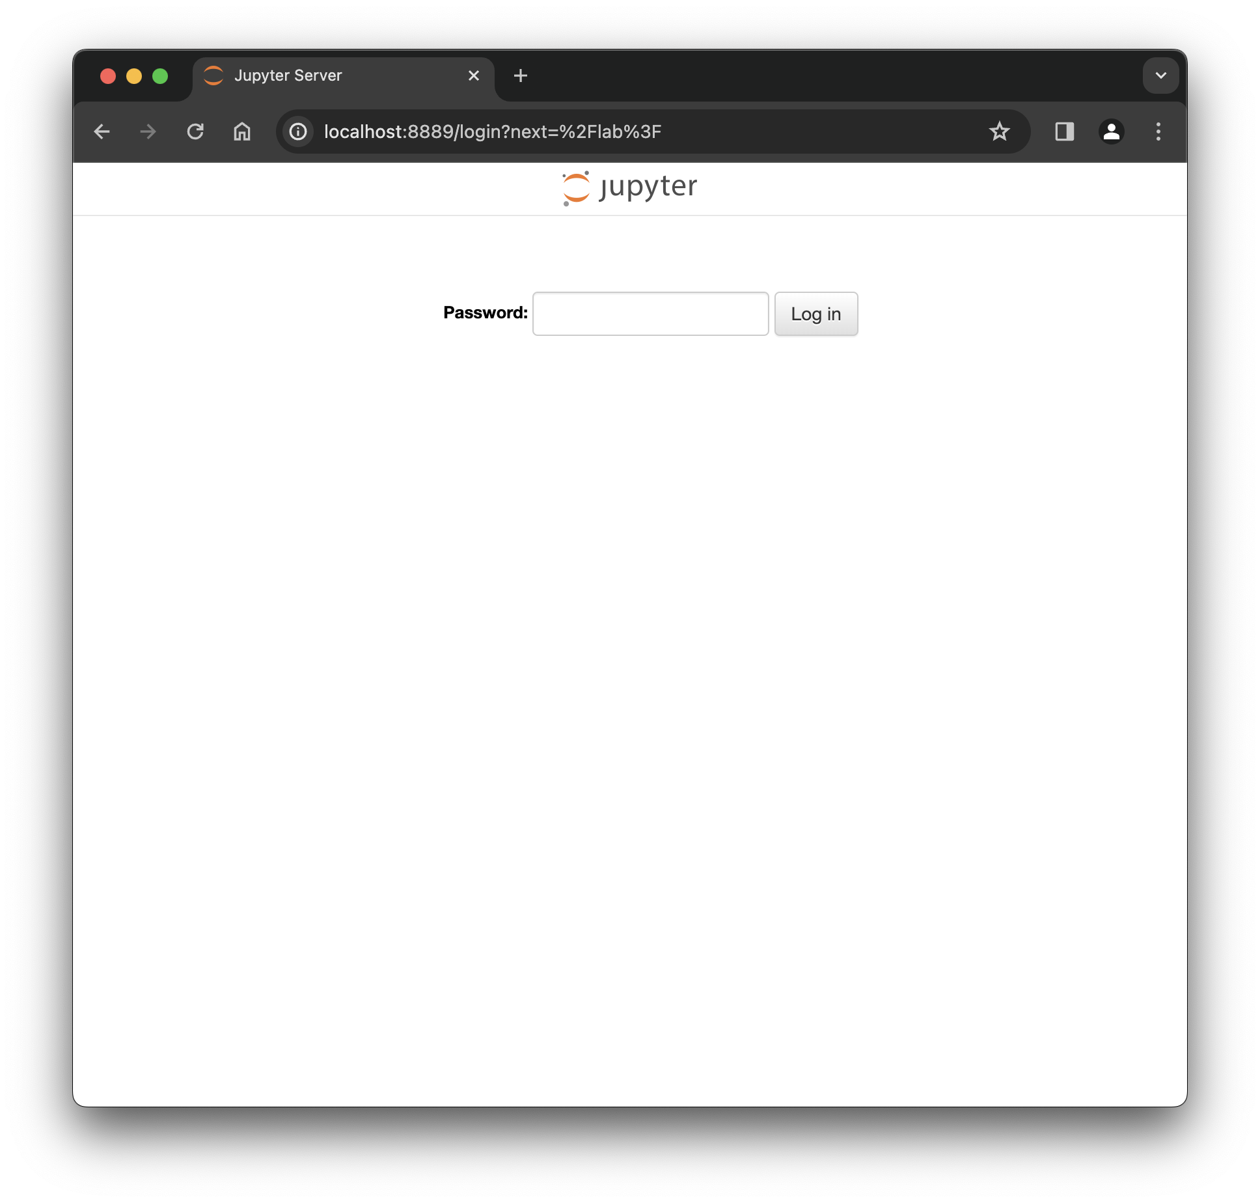
Jupyter Notebook
Enter Password:
icerm2024

Slide 22
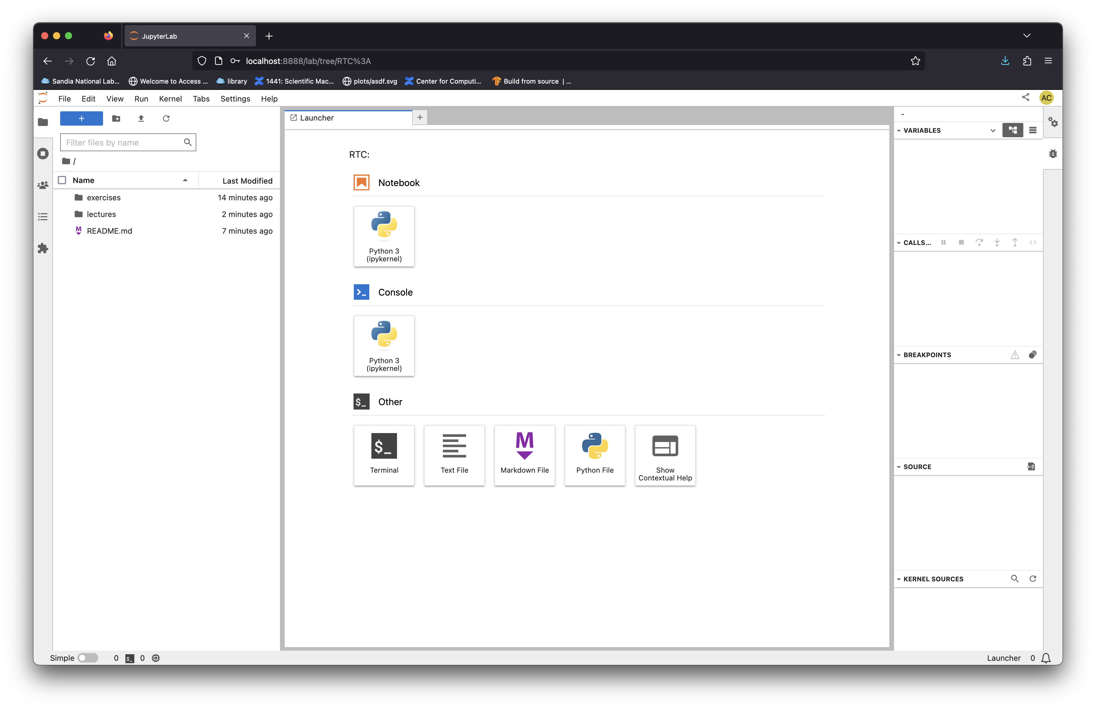

Slide 23
Content for this tutorial
You’ll be working off notebooks in exercises

Slide 24
If you need, you can start a new notebook here

Slide 25
Notice RTC (Real Time Collaboration) in the URL

Slide 26
Let’s open exercises/1_gradient.ipynb

Slide 27
Exercise
Follow the previous slides to open the exercises/1_gradient.ipynb notebook
Compute the gradient of Ax for a random matrix, A, and vector, x
Experiment with tf.function, jit, and running on the CPU/GPU
Experiment with Jupyter’s debugger

